Slide 1
Power BI Dashboard
This Dashboard will help business stakeholders to find insights about the business.

Slide 2
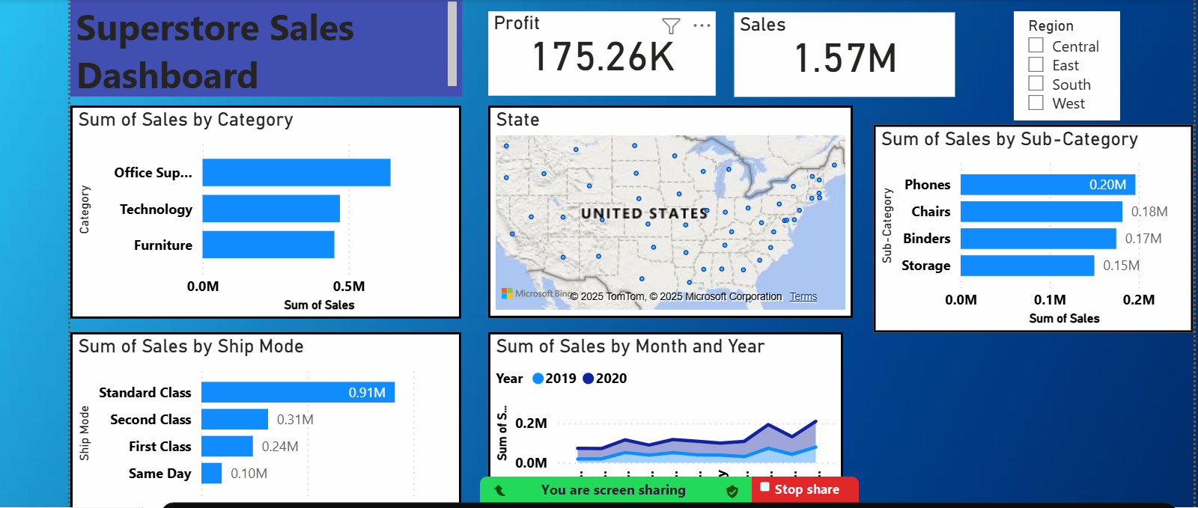
Full View of Super Store Sales Dashboard

Slide 3
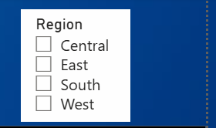
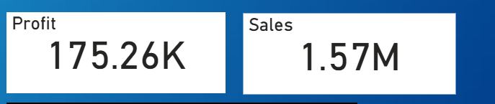
1- With the help of slicer I have created filter on regions, which will help to see the region wise sales.
2- I have added cards as given below in image, which is generally used to show totals of any column like sales or profit etc.

Slide 4
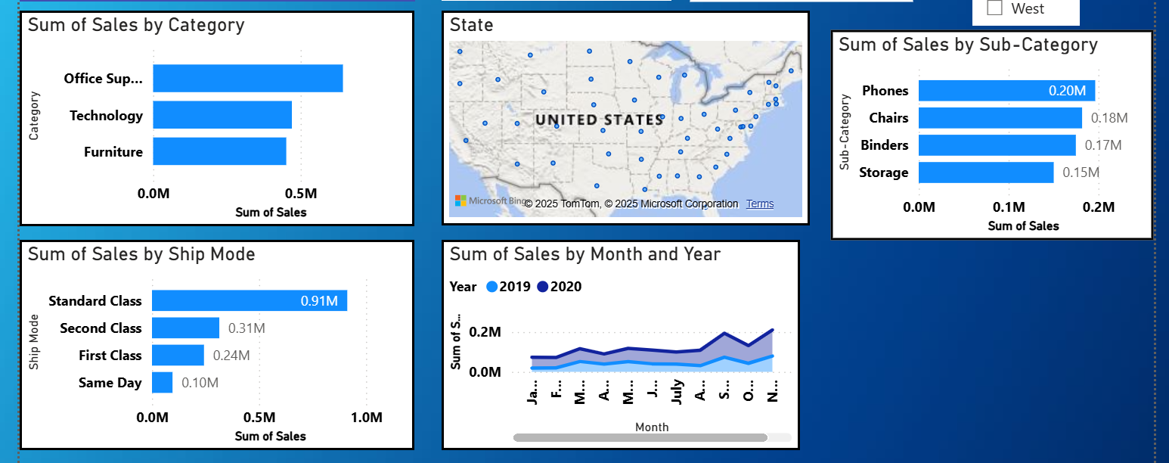
1- These are bar graph which is helping to show category and subcategory wise sales. And we can also change the sales according to region.
2- I have also added time serios charts which shows up and down in sales monthly and yearly wise.

Slide 5
Thank You

